Slide 1

Climate Affection on Bird Population Course : Math205 under the supervision of: Dr. Ethar & TA. Amr Elazzazy

Slide 2






Team members
Yusuf Mohamed
211001949
Ahmed salah
211001546
Omar Atef
211000376
Jaser Osama
211001801
Mohamed Tamer
211000379
Youssef Sayed
211001963

Slide 3

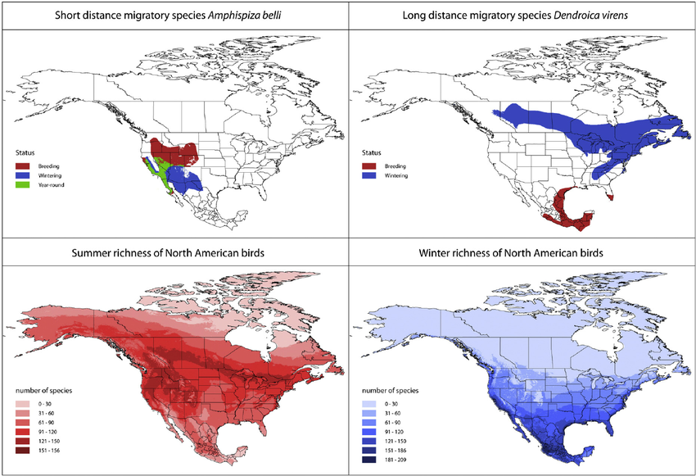
Content list
Introduction
Population Dynamics and Biomass
Flow Model
Methodology
Results

Slide 4
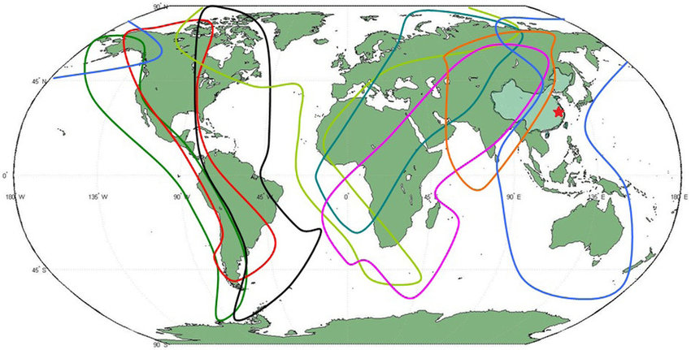
Introduction
By utilizing geographically unique places at various times of the year, migratory populations can successfully define an annual existence infrastructure that would otherwise be unusable, reducing the negative effects of seasonal fluctuation. However, this strength might turn into a weakness in the event of severe climate change. Typically, migrants use their own internal cs and/or external clues to determine when it is time to leave a certain area.

Slide 5
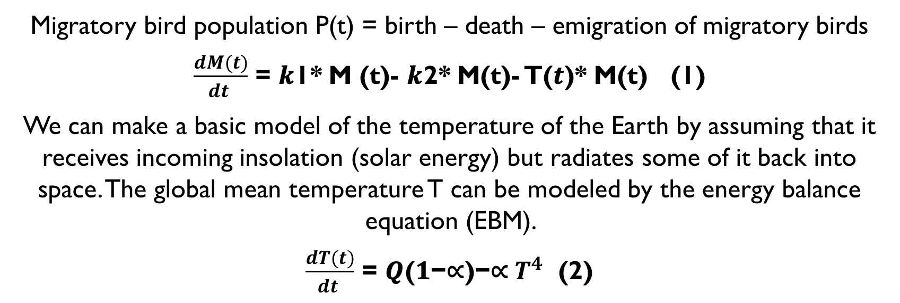
Methodology
Migratory bird population P(t) = birth – death – emigration of migratory birds
$\frac{dM(t)}{dt }$ = 𝒌1* M (t)- 𝒌2* M(t)- T(𝒕)* M(t) (1)
We can make a basic model of the temperature of the Earth by assuming that it receives incoming insolation (solar energy) but radiates some of it back into space. The global mean temperature T can be modeled by the energy balance equation (EBM).
$\frac{dT(t)}{dt }$ = 𝑸(𝟏−∝)−∝ $T^{4}$ (2)

Slide 6
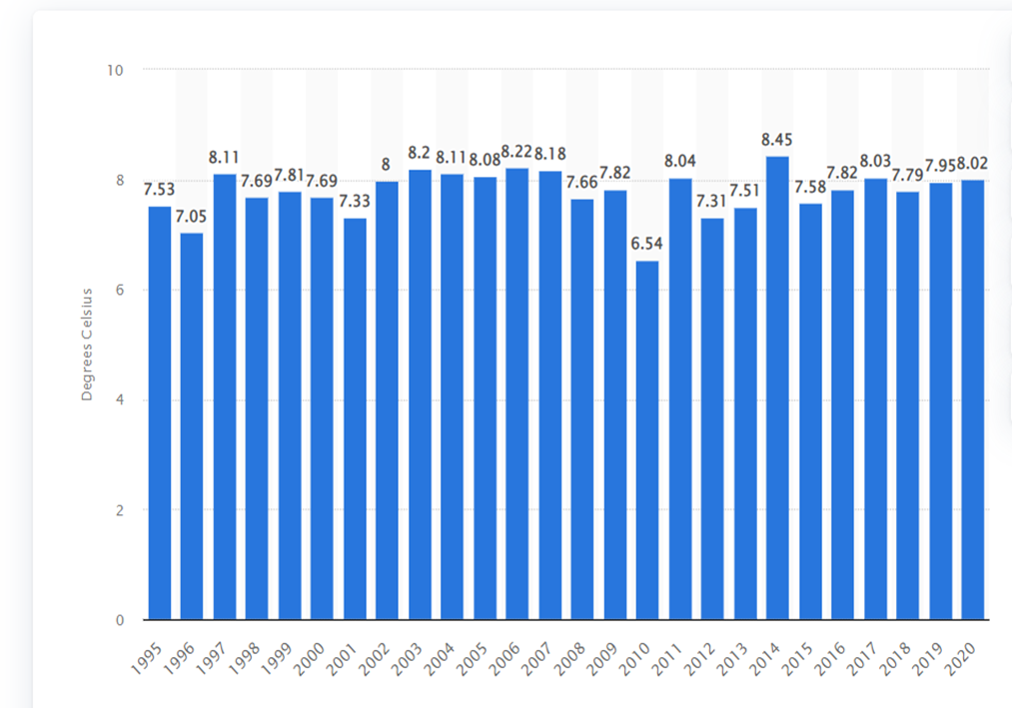
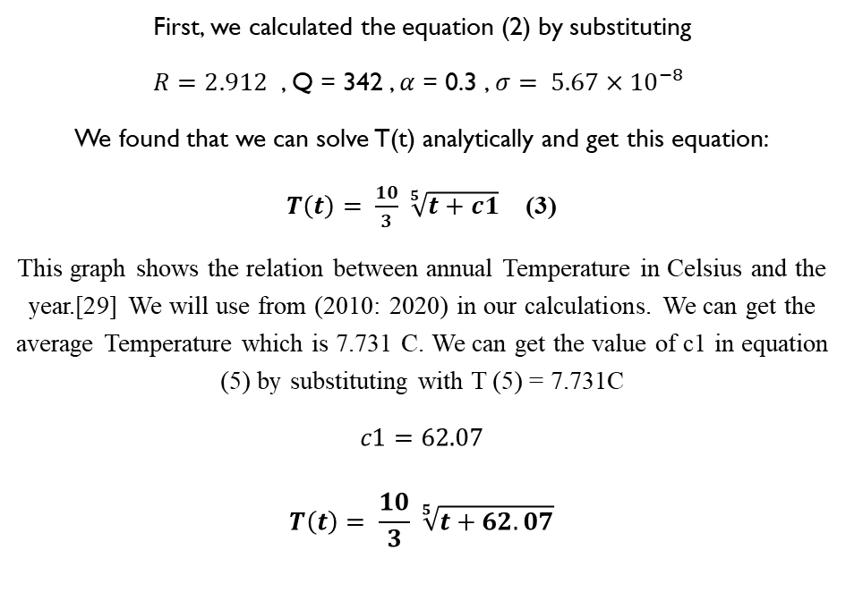
Methodology
First, we calculated the equation (2) by substituting
$R=2.912$ , Q = 342 , $α$ = 0.3 , $σ= 5.67×{10}^{−8}$
We found that we can solve T(t) analytically and get this equation:
$T\left(t\right)= \frac{10}{3} \sqrt[5]{t+c1}$ (3)
This graph shows the relation between annual Temperature in Celsius and the year.[29] We will use from (2010: 2020) in our calculations. We can get the average Temperature which is 7.731 C. We can get the value of c1 in equation (5) by substituting with T (5) = 7.731C
$$c1=62.07$$
$$T\left(t\right)= \frac{10}{3} \sqrt[5]{t+62.07}$$

Slide 7
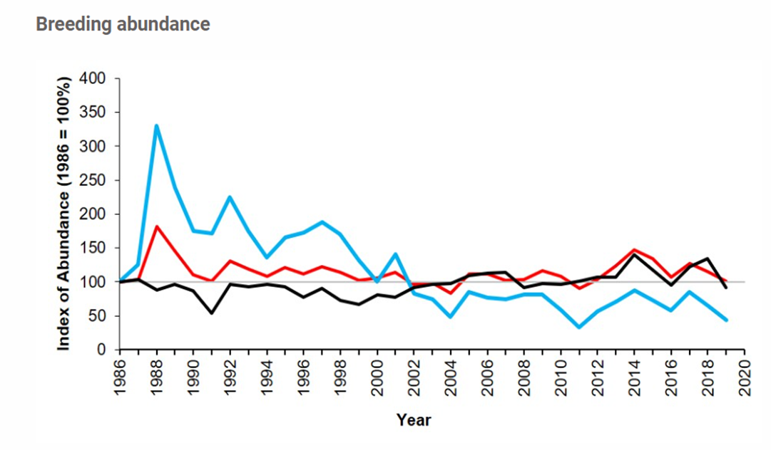
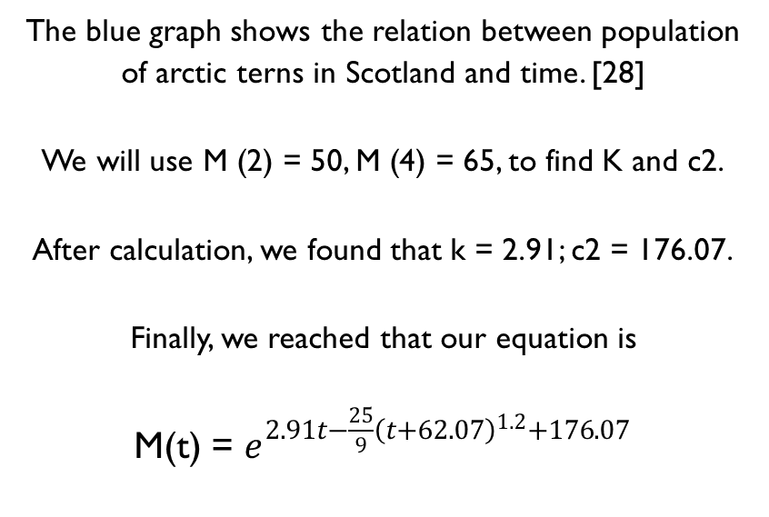
Methodology
The blue graph shows the relation between population of arctic terns in Scotland and time. [28]
We will use M (2) = 50, M (4) = 65, to find K and c2.
After calculation, we found that k = 2.91; c2 = 176.07.
Finally, we reached that our equation is
M(t) = $e^{2.91t−\frac{25}{9}{\left(t+62.07\right)}^{1.2}+176.07}$

Slide 8
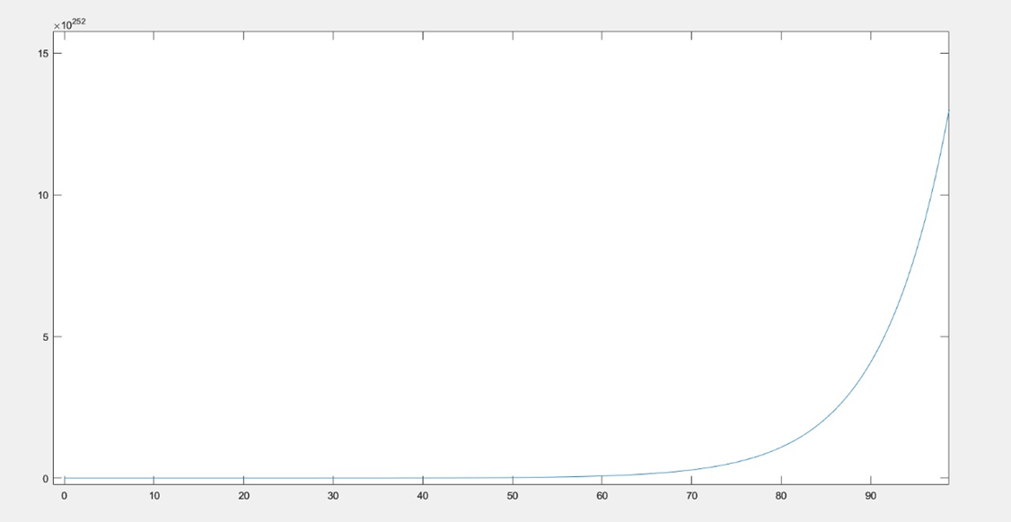
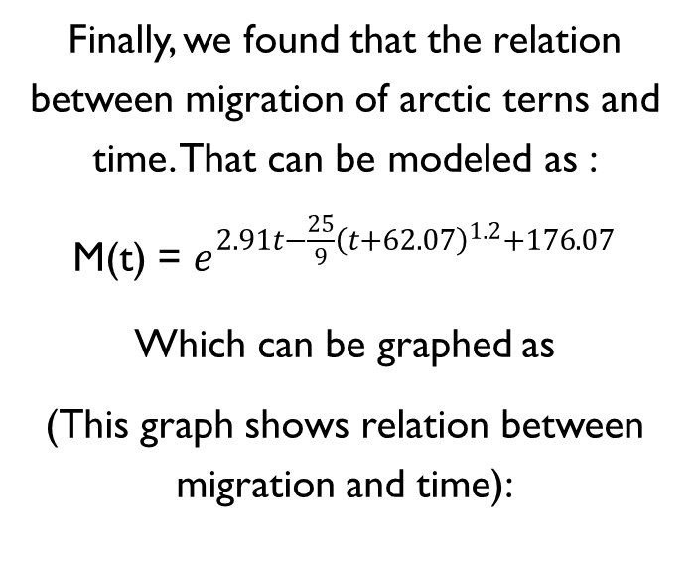
Results
Finally, we found that the relation between migration of arctic terns and time. That can be modeled as :
M(t) = $e^{2.91t−\frac{25}{9}{\left(t+62.07\right)}^{1.2}+176.07}$
Which can be graphed as
(This graph shows relation between migration and time):

Slide 9
References
[1]Visser, M.E., Holleman, L.J.M., Gienapp, P., 2006. Shifts in caterpillar biomass phenology due to climate change and its impact on the breeding biology of a bird. Oecologia 147, 164–172.
[2]Gauthreaux, S.A., 1980. Animal Migration, Orientation and Navigation. Academic Press, New York.
[3]Carey, C., 2009. The impacts of climate change on the annual cycles of birds. Philos. Trans. R. Soc. London, Ser. B: Biol. Sci. 364 (1534), 3321–3330.
[4]MacMynowski, D.P., Root, T.L., 2007. Climate and the complexity of migratory phenology: sexes, migratory distance, and arrival distributions. Int. J. Biometeorol. 51 (5), 361–373.
[5]Walther, G.-R., Post, E., Convey, P., Menzel, A., Parmesan, C., Beebee, T.J.C., Fromentin, J.-M., HoeghGuldberg, O., Bairlein, F., 2002. Ecological responses to recent climate change. Nature 416, 389–395.
[6]Visser, M.E., Both, C., 2005. Shifts in phenology due to global climate change: the need for a yardstick. Proc. R. Soc. B: Biol. Sci. 272, 2561–2569.
[7]Butler, C.J., 2003. The disproportionate effect of global warming on the arrival dates of short-distance migratory birds in north america. Ibis 145, 484–495.
[8]Jonzén, N., Lindén, A., Ergon, T., Knudsen, E., Vik, J.O., Rubolini, D., Piacentini, D., Brinch, C., Spina, F., Karlsson, L., Stervander, M., Andersson, A., Waldenström, J., Lehikoinen, A., Edvardsen, E., Solvang, R., Stenseth, N.C., 2006. Rapid advance of spring arrival dates in long-distance migratory birds. Science 312 (5782), 1959–1961.
[9]Both, C., Visser, M.E., 2001. Adjustment to climate change is constrained by arrival date in a long-distance migrant bird. Nature 411, 296–298.
[10]Both, C., Bouwhuis, S., Lessells, C.M., Visser, M.E., 2006. Climate change and population declines in a long-distance migratory bird. Nature 441, 81–83.
[11]Miller-Rushing, A.J., Lloyd-Evans, T.L., Primack, R.B., Satzinger, P., 2008. Bird migration times, climate change, and changing population sizes. Global Change Biol. 14, 1959–1972.
[12]Buse, A., Dury, S.J., Woodburn, R.J.W., Perrins, C.M., Good, J.E.G., 1999. Effects of elevated temperatures on multi-species interactions: the case of pedunculate oak, winter moth and tits. Funct. Ecol. 13, 74–82.
[13] Visser, M.E., van Noordwijk,A.J., Tinbergen,J.M., Lessells, C.M., 1998.Warmer springs lead to mistimed reproduction in great tits (parus major). Proc.: Biol. Sci. 265 (1408), 1867–1870.
[14] Visser, M. E., Both, C. & Lambrechts, M. M. Global climate change leads to mistimed avian reproduction.
Adv. Ecol. Res. 35, 89–110 (2004).
[15] Stenseth, N. C. et al. Ecological effects of climate fluctuations. Science 297, 1292–1296 (2002).
[16] M. R. Fuller, W. S. Seegar, and P. W. Howey, “The use of satellite systems for the study of bird migration,” Israel Journal of Zoology, vol. 41, no. 3, pp. 243–252, 1995.

Slide 10
References
[17]P. Berthold, Bird Migration: A General Survey, Oxford University Press, New York, NY, USA, 2nd edition, 2001, Translated by H. Gunther Bauer and V. Westhead. ¨
[18]C. Both, S. Bouwhuis, C. M. Lessells, and M. E. Visser, “Climate change and population declines in a longdistance migratory bird,” Nature, vol. 441, no. 1, pp. 81–83, 2006.
[19]C. E. Studds and P. P. Marra, “Reconsidering the role of precipitation and food availability in relation to the effect of photoperiod on spring departure of a migratory bird,” Proceeding of the Royal Society B, vol. 279, no.
1726, pp. 17–18, 2011.
[20]A. P. Møller, D. Rubolini, and E. Lehikoinen, “Populations of migratory bird species that did not show a phenological response to climate change are declining,” Proceedings of the National Academy of Sciences of the United States of America, vol. 105, no. 42, pp. 16195–16200, 2008.
[21]F. Bairlein and M. Schaub, “Ringing and the study of mechanisms of migration,” Ringing & Migration, vol.
24, no. 3, pp. 162– 168, 2009.
[22]M. E. Visser, “Keeping up with a warming world; assessing the rate of adaptation to climate change,” Proceedings of the Royal Society B, vol. 275, no. 1635, pp. 649–659, 2008.
[23]“Migratory birds that travel incredible distances,” Bird Informer, 04-Nov-2021. [Online]. Available: https://www.birdinformer.com/migratory-birds/. [Accessed: 26-Nov-2022].
[24]S. Stöcker-Segre and D. Weihs, “Impact of environmental changes on Migratory bird survival,” International Journal of Ecology, 19-Feb-2014. [Online]. Available:
https://www.hindawi.com/journals/ijecol/2014/245849/#EEq1. [Accessed: 26-Nov-2022].
[25] H. A. Dijkstra, “Mathematics and climate by Hans Kaper and Hans Engler - The Mathematical Intelligencer,” SpringerLink, 16-May-2015. [Online]. Available: https://link.springer.com/article/10.1007/s00283-015-9545-x. [Accessed: 17-Dec-2022].
[26] “A simple global carbon and energy coupled cycle ... - wiley online library.” [Online]. Available: https://onlinelibrary.wiley.com/doi/full/10.1034/j.1600-0889.2003.00035.x. [Accessed: 17-Dec-2022].
[27] “Oberlin College and Conservatory.” [Online]. Available: https://www2.oberlin.edu/math/faculty/walsh/UMAPclimate.pdf. [Accessed: 26-Nov-2022].
[28] “Arctic tern (Sterna paradisaea),” JNCC. [Online]. Available: https://jncc.gov.uk/our-work/arctic-tern-sterna-paradisaea/. [Accessed: 22-Dec-2022].
[29] M. Jaganmohan, “Annual mean temperature Scotland 1995-2020,” Statista, 07-Jul-2022. [Online]. Available: https://www.statista.com/statistics/367853/scotland-average-temperature/. [Accessed: 22-Dec-2022].

Slide 11

Thank You

